Slide 2
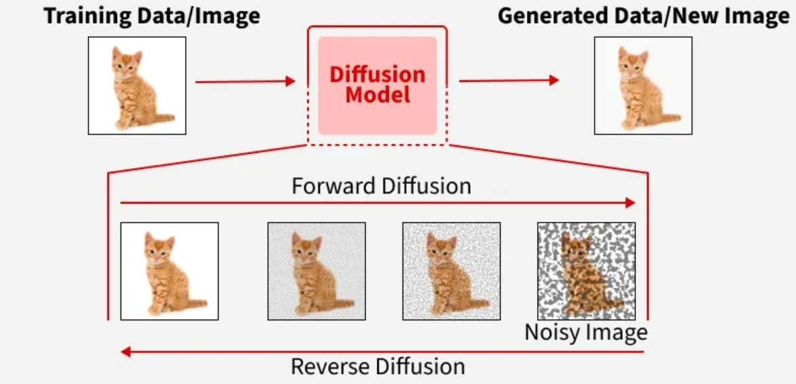
What is a Diffusion Model?
Diffusion models gradually add noise to real images during training, then learn to reverse this process so they can generate new images from pure noise.

Slide 3
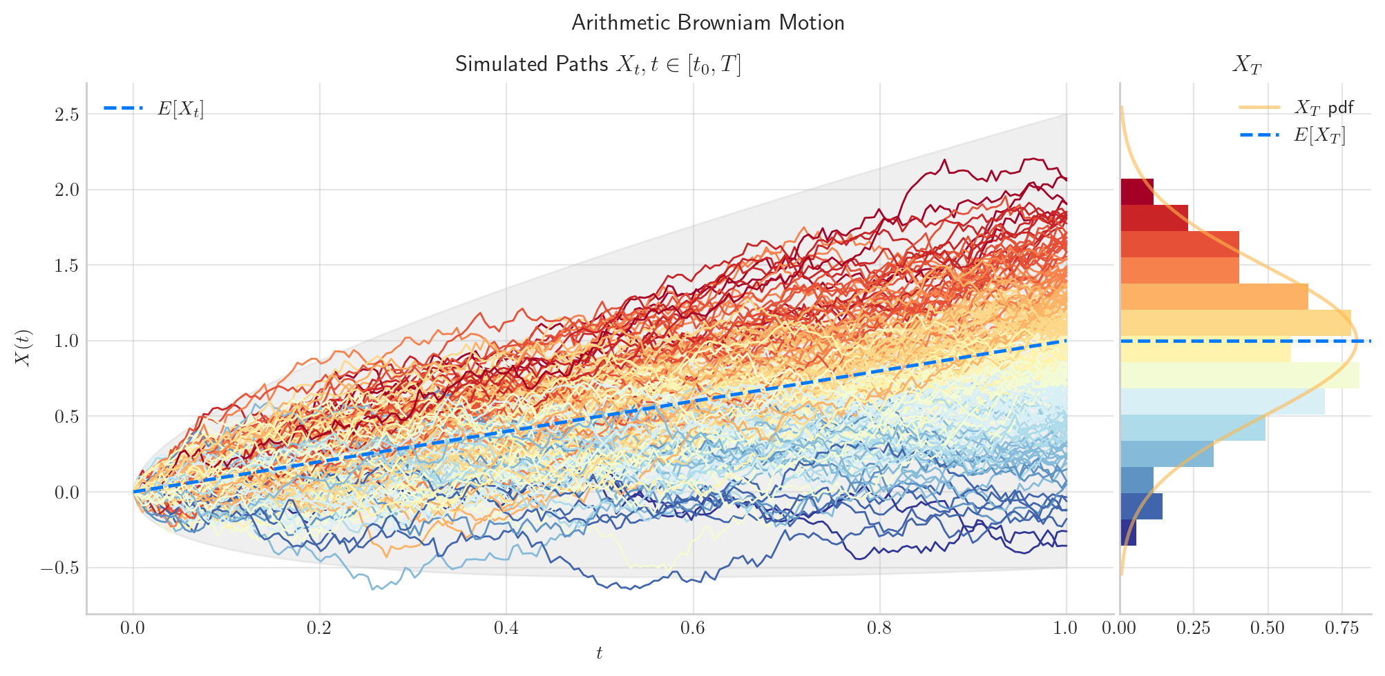
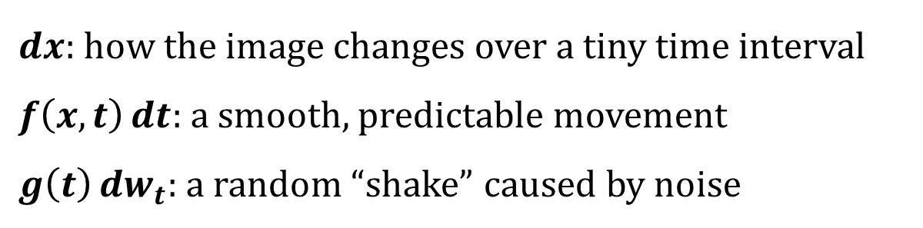
Diffusion as an SDE
$$dx=f\left(x,t\right) dt+g\left(t\right) dw_{t}$$
$dx:$ how the image changes over a tiny time interval
$f\left(x,t\right) dt:$ a smooth, predictable movement
$g\left(t\right) dw_{t}:$ a random “shake” caused by noise

Slide 4
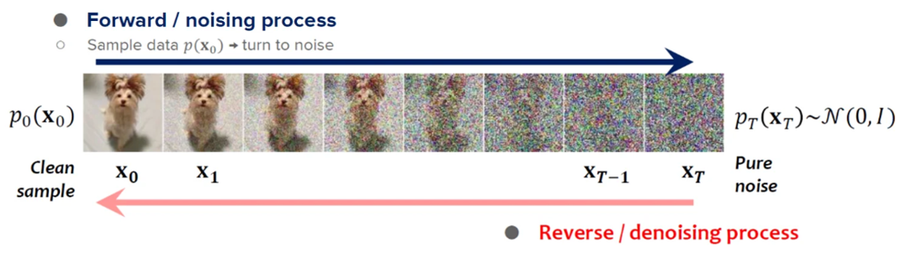
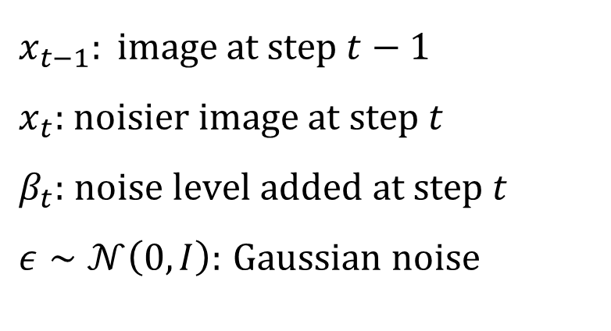

Forward Process: Gradually Adding Noise
$$q\left(x_{t} ∣ x_{t−1}\right)=𝓝\left(x_{t};\sqrt{1−β_{t}} x_{t−1}, β_{t}I\right)$$
$$x_{t}=\sqrt{1−β_{t}} x_{t−1}+\sqrt{β_{t}} ε, ε∼𝓝\left(0,I\right)$$
$$x_{t−1}: \text{image} \text{at} \text{step} t−1$$
$x_{t}:$ $\text{noisier} \text{image} \text{at} \text{step} t$
$β_{t}:$ $\text{noise} \text{level} \text{added} \text{at} \text{step} t$
$ε∼𝒩\left(0,I\right):$ $\text{Gaussian} \text{noise}$

Slide 5
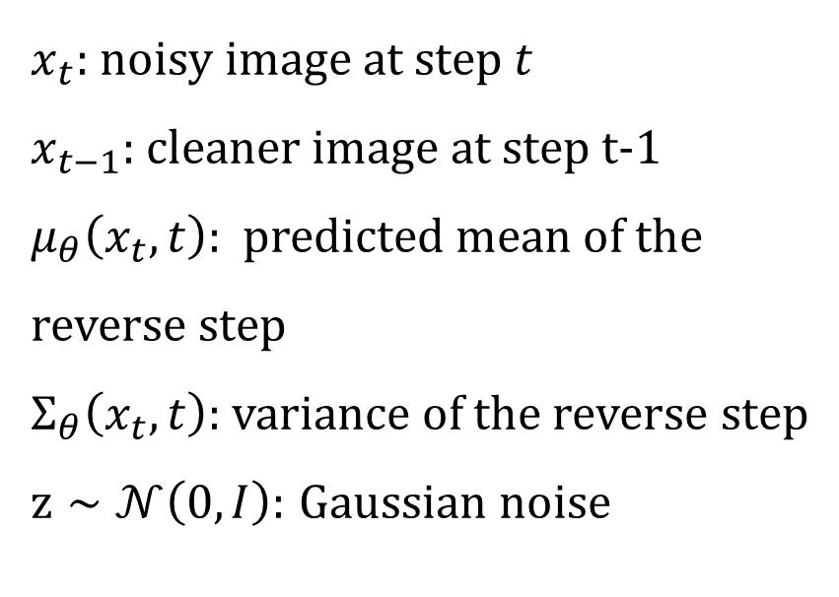

Backward Process: From Noise to Image
$$p_{θ}\left(x_{t−1} ∣ x_{t}\right)=𝓝\left(x_{t−1};μ_{θ}\left(x_{t},t\right),Σ_{θ}\left(x_{t},t\right)\right)$$
$$x_{t−1}=μ_{θ}\left(x_{t},t\right)+σ_{t}z, z∼𝓝\left(0,I\right)$$
$x_{t}:$ $\text{nois}\text{y} \text{image} \text{at} \text{step} t$
$x_{t−1}:$ cleaner image at step t-1
$μ_{θ}\left(x_{t},t\right):$ predicted mean of the reverse step
$Σ_{θ}\left(x_{t},t\right):$ variance of the reverse step
$z∼𝒩\left(0,I\right):$ $\text{Gaussian} \text{noise}$

Slide 6
Why is diffusion slow?
Reverse generation requires many denoising steps
More steps usually give better quality, but increase latency
This makes diffusion hard to deploy in real-time or resource-limited settings

Slide 7
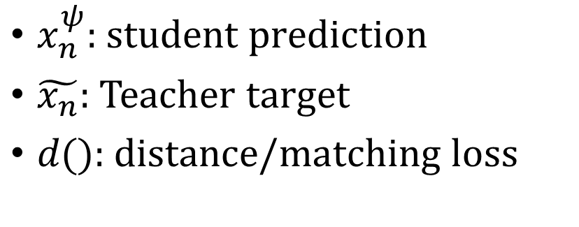

$$ℒ\left(ψ\right)=d\left(x_{n}^{ψ},\tilde{x_{n}}\right)$$
$x_{n}^{ψ}\text{: }\text{student} \text{prediction}$
$\tilde{x_{n}}$: Teacher target
$d\text{()}\text{: }\text{distance}\text{/}\text{matching} \text{loss}$

